Slide 1
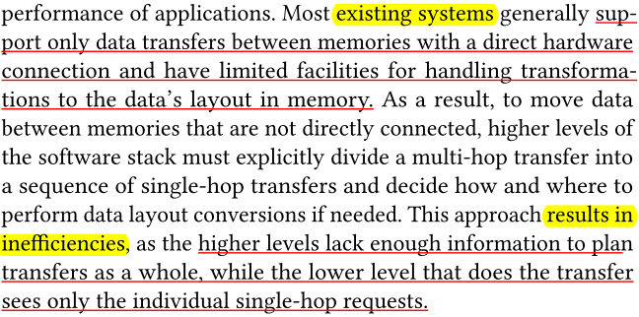
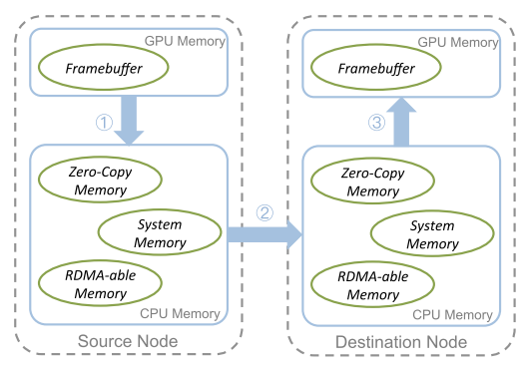
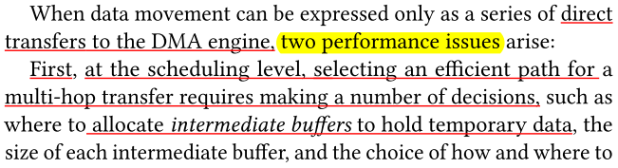
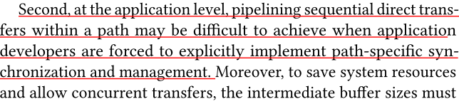
Notes: Isometry: A Path-Based Distributed Data Transfer System ^{[1]}
I. Applications
II. Challenges
Path-based distributed data transfer system.
Source and destination
Data transfer path
From: Framebuffer, GPU Memory, Source Node
To: Framebuffer, GPU Memory, Destination Node
Figure 1: Data transfer between GPU framebuffers on different nodes [1].
[1] https://dl.acm.org/doi/10.1145/3205289.3205301

Slide 2
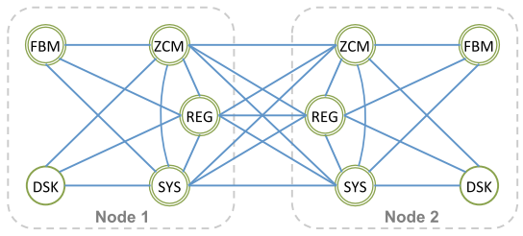
Notes: Isometry: A Path-Based Distributed Data Transfer System ^{[1]}
III. Methods-Summary
IV. Conclusions
Using graph, dynamically select efficient paths for data transfers based on the connectivity between memories, the bandwidth for each connection, and the layout of the instance (a collection of data in a specific memory) being transferred. Please refer to next pages for details.
Speed up data transfers to 2.2×.
Reduce the completion time of high priority transfers by up to 95% compared to the baseline Realm data transfer system.
Evaluate Isometry on three benchmarks and show that Isometry reduces transfer time by up to 80% and overall completion time by up to 60%.
Memory
Data transfer channel
Path 1
Path 2
[1] https://dl.acm.org/doi/10.1145/3205289.3205301

Slide 3
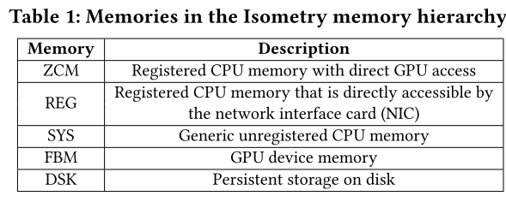
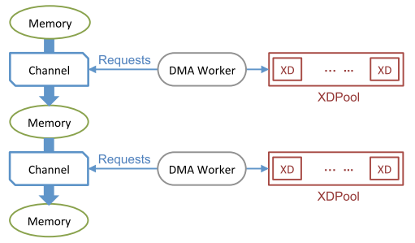
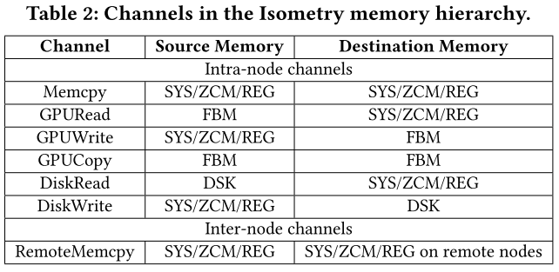
Notes: Isometry: A Path-Based Distributed Data Transfer System ^{[1]}
III. Methods-Model and Definitions
Memory Types
DMA: Direct memory access
XD: transfer descriptor
Transfer Channels
Given memory types and transfer channels,
find data transfer paths that can speed up performance.
* Tables and figures source: [1]
[1] https://dl.acm.org/doi/10.1145/3205289.3205301

Slide 4
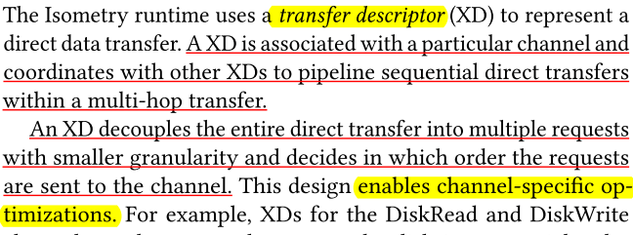
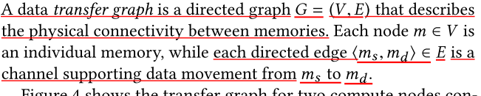
Notes: Isometry: A Path-Based Distributed Data Transfer System ^{[1]}
III. Methods-Model and Definitions
Method: Use data transfer graph, as below.
Each circle is a memory (Table 1); each edge is a transfer channel (Table 2).
DMA: Direct memory access
XD: transfer descriptor
s
Next: set up the graph.
* Tables and figures source: [1]
[1] https://dl.acm.org/doi/10.1145/3205289.3205301

Slide 5
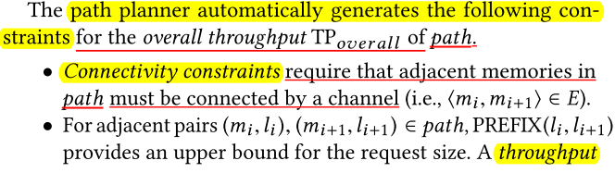
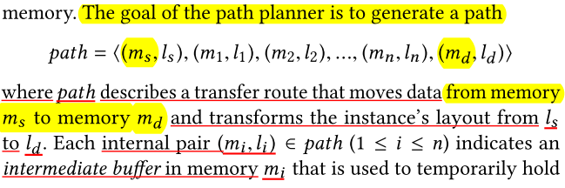
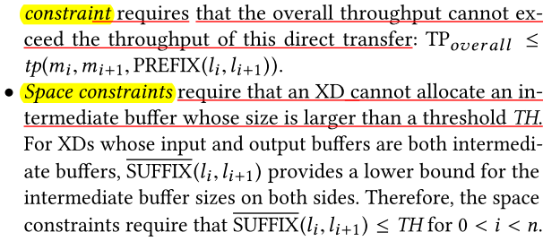
Notes: Isometry: A Path-Based Distributed Data Transfer System ^{[1]}
III. Methods-How to find the optimal path
[1] https://dl.acm.org/doi/10.1145/3205289.3205301

Slide 6
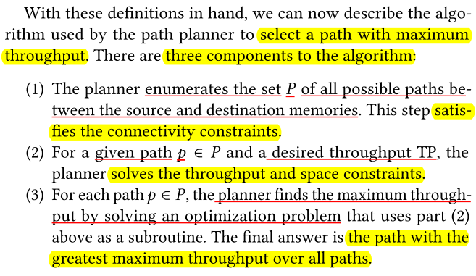
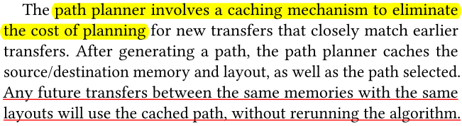
Notes: Isometry: A Path-Based Distributed Data Transfer System ^{[1]}
III. Methods-How to ind the optimal path
In addition:
[1] https://dl.acm.org/doi/10.1145/3205289.3205301

Slide 7
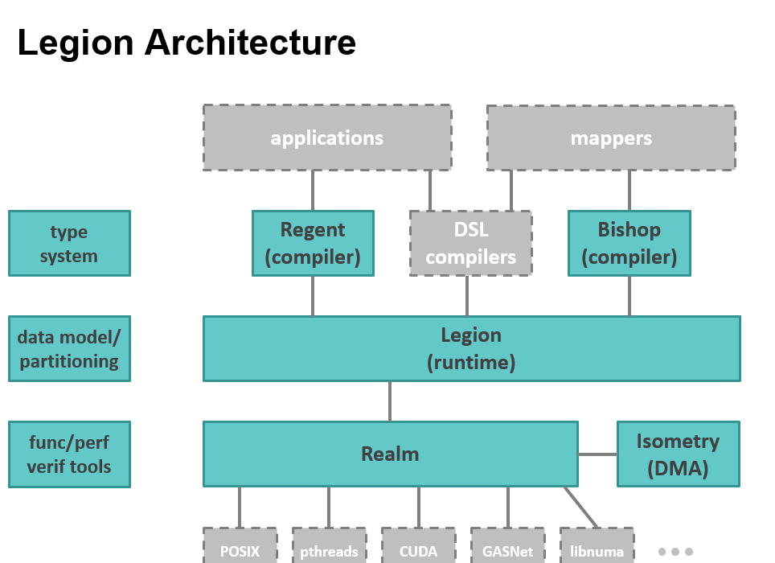
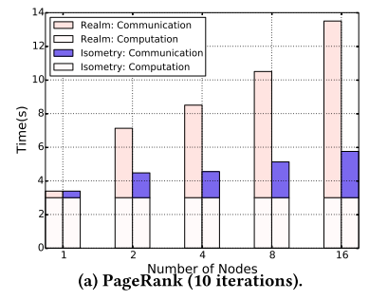
Notes: Isometry: A Path-Based Distributed Data Transfer System ^{[1]}
V. Experiment
Evaluate 5 scenarios:
Pipelining direct transfers
Priority scheduling
Path Planning Algorithms
Comparison with Multi-hop DMA Engine
Compare with 3 benchmarks: PageRank, Circuit, and VGG-16.
Results are promising. As an example, the figure below shows the results of benchmark PageRank. Note that the communication time was significantly reduced.
Figure source: [2]
Figure source: Figure 12 of [1].
[2] https://www.olcf.ornl.gov/wp-content/uploads/2016/01/Legion_Elliott_Slaughter.pptx
[1] https://dl.acm.org/doi/10.1145/3205289.3205301

